Slide 1



Introduction to Web Development
Discover the fascinating world of creating websites with HTML, CSS, and JavaScript. Learn how to bring your ideas to life on the web.
by Mohit Kumar

Slide 2

About the Organization - Vital Vishwa Publications Pvt. Ltd.
Vital Vishwa Publications Pvt. Ltd. is a publishing company based in Netaji Subhash Palace, New Delhi India. It was founded by Vishwa Mohan Singh, who is also the founder of Progressive Business Club and Success Miracle. The company publishes a variety of books, including self-help, motivational, and business books. It also offers author training and coaching services. Here are some of the company's notable achievements:
● Vishwa Mohan Singh has been recognized as an Amazon Best Seller Author.
● The company has published books that have reached the top of Amazon's bestseller lists.
Here are some of the company's services:
● Book publishing
● Author training
● Book marketing Card Title

Slide 3

HTML: Building Blocks of the Web
Structure
HTML (Hypertext Markup Language) provides the foundation for structuring web content, from headings to paragraphs and lists.
Semantics
Using HTML tags like <article> and <nav> adds meaning and context to the content for search engines and accessibility.
Forms
Collect user input with form elements like <input> and handle data submission to create interactive web experiences.

Slide 4
CSS: Styling the Web
1
Design
CSS (Cascading Style Sheets) allows you to tailor the visual appearance of your web pages, including colors, fonts, layouts, and animations.
2
Responsive
Make your websites adapt to different screen sizes and devices, providing a seamless experience for all users.
3
Selectors
Select specific HTML elements and apply styles with class selectors, ID selectors, and advanced CSS selectors.

Slide 5

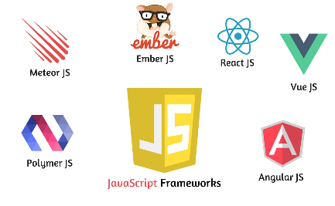

JavaScript: Adding Interactivity
Dynamism
Frameworks
Libraries
Bring your websites to life with JavaScript, allowing for dynamic content, user interactions, and data manipulation.
Explore popular JavaScript frameworks like React, Angular, and Vue.js to build powerful and efficient web applications.
Utilize JavaScript libraries such as jQuery and lodash to streamline and simplify common web development tasks.

Slide 6

Bootstrap: Rapidly Building Websites
1
Efficiency
Bootstrap provides a pre-built collection of CSS and JavaScript components, empowering developers to create responsive websites quickly.
2
Grid System
Take advantage of Bootstrap's responsive grid system to create flexible and consistent layouts across different screen sizes.
3
Customization
Extend Bootstrap's capabilities by customizing themes, styles, and components to match your unique design requirements.

Slide 7

The Disadvantages of Using Bootstrap
1
Code Bloat
Bootstrap's extensive CSS and JavaScript library can result in larger file sizes and slower load times compared to custom-built solutions.
2
Dependency on Framework
Reliance on Bootstrap can limit the flexibility and creativity of your designs, leading to websites that look similar to others.
3
Learning Curve
Mastering Bootstrap may require additional time and effort, especially for developers who prefer to write their own CSS and JavaScript code.

Slide 8
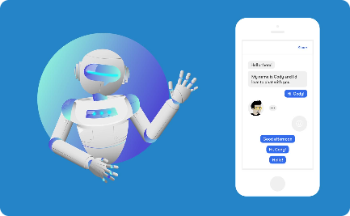


Chat GPT and Google Bard: Conversational AI
Seamless Communication
Advanced Natural Language Processing
Virtual Assistants
Explore the potential of conversational AI in creating virtual assistants that assist with tasks, provide information, and facilitate productivity.
Discover the world of conversational AI with Chat GPT and Google Bard, revolutionizing interactions between humans and machines.
Experience AI-powered chatbots that understand and respond to human language, improving customer support and user engagement.

Slide 9

The Importance of Adobe Illustrator in Web Design
Visual Design
Adobe Illustrator empowers designers to create stunning visuals, illustrations, and logos that elevate the aesthetics of web layouts.
Scalability
Create vector graphics that can be scaled up or down without losing quality, ensuring crisp and sharp images across different devices.
Collaboration
Effortlessly collaborate with other designers and developers by easily exporting Illustrator files for web development projects.

Slide 10

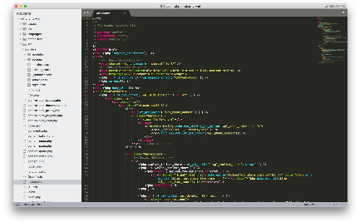

VS Code: The Perfect Web Development IDE
Intuitive Interface
Powerful Coding Features
Web Development Tools
Experience a clean and user-friendly interface that enhances productivity with VS Code's customizable layout and extensive plugin ecosystem.
Access a wide range of web development tools and extensions in VS Code, tailored to improve efficiency and code quality.
Take advantage of intelligent code suggestions, built-in version control, and debugging tools to streamline your web development workflow.

Slide 11

Github: Version Control and Collaboration
1
Version Control
Manage and track changes to your projects with Git and GitHub, allowing for easy collaboration and code management across teams.
2
Repository Hosting
Store your code securely in GitHub repositories, enabling others to view, contribute, and fork your projects for open-source collaboration.
3
Issue Tracking
Utilize GitHub's issue tracking system to improve project management, assign tasks, and communicate with your development team effectively.

Slide 12
Netlify: Scalable Web Hosting and Deployment
1
Continuous Deployment
Seamlessly integrate your Git repositories with Netlify, enabling automated deployments with every code commit.
Global Content Delivery Network
2
Leverage Netlify's global CDN to ensure fast loading times and optimal performance for your web applications worldwide.
3
Forms and Functions
Easily handle form submissions and serverless functions with Netlify, simplifying backend processes without the need for a dedicated server.

Slide 13

Skills we have acquired…
Designing and Developing Websites.
How to give more effective prompt to an AI chatbot.
How to host a website on online servers.
How to implement client's requirements.
Teamwork.
Theory of Designing.
How to tackle problems.

Slide 14

Scope of further improvement…
User interaction system.
AI Chatbot.
Introduce Modularity using React or make it component based website.
Add embedded e-shop functionality.

Slide 15

Thank You!
We sincerely appreciate your time and attention. It has been a pleasure sharing our summer internship story and experiences with you.

